Slide 1
The Numbers
of

Slide 3
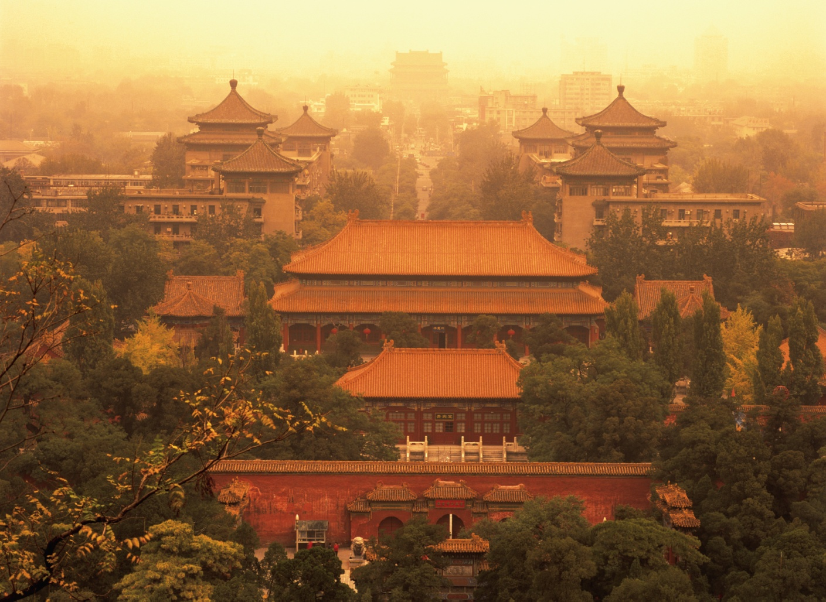
Descriptions
For centuries China stood as a leading civilization, outpacing the rest of the world in the arts and sciences, but in the 19th and early 20th centuries, the country was beset by civil unrest, major famines, military defeats, and foreign occupation.

Slide 4
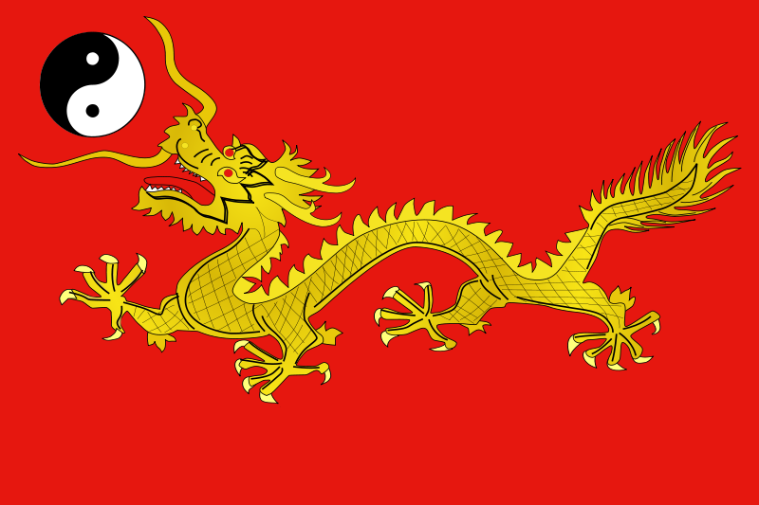
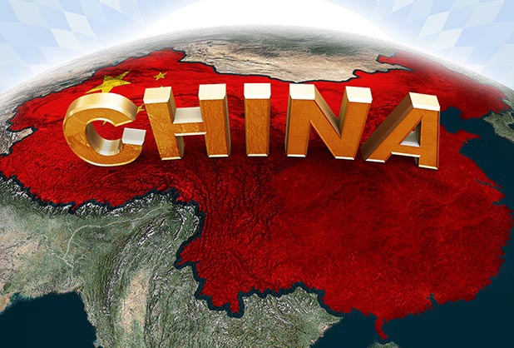
Descriptions
After World War II, the communists under MAO Zedong established an autocratic socialist system that, while ensuring China's sovereignty, imposed strict controls over everyday life and cost the lives of tens of millions of people. After 1978, MAO's successor DENG Xiaoping and other leaders focused on market-oriented economic development and by 2000 output had quadrupled.

Slide 5
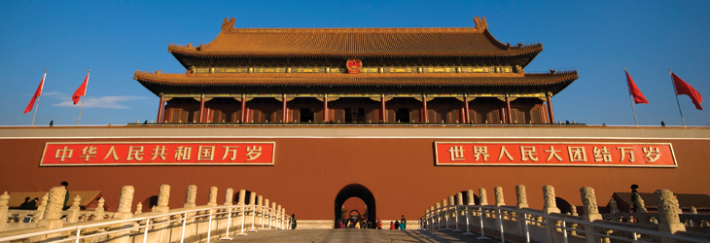
Descriptions
For much of the population, living standards have improved dramatically and the room for personal choice has expanded, yet political controls remain tight. Since the early 1990s, China has increased its global outreach and participation in international organizations.

Slide 6
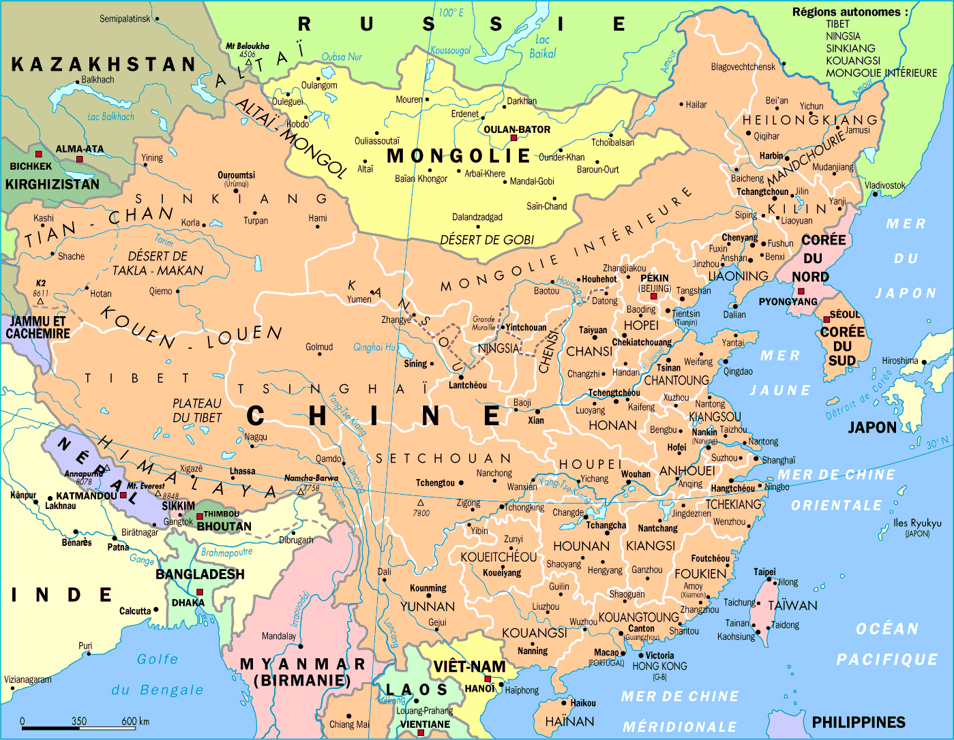
The Biggest Population 1,355,692,576
Total: 9,596,960 Sq Km
Land: 9,326,410 Sq Km
Water: 270,550 Sq Km
Country Comparison To The World: 4

Slide 8
@2014

Slide 9
Life Expectancy

Slide 10
@2014

Slide 11
@2012

Slide 12
@2010

Slide 13
@2011

Slide 14
The Numbers of

Slide 15
@2014

Slide 16
Unemployment

Slide 17
@2013

Slide 18
Maternal Mortality Rate

Slide 19
Thank You

